Slide 1

Using Machine Learning to Address the Opioid Crisis
Megan Skrobacz, Matthew Menzi, Yoselyn Cervantes, Adithya Chundailthodi

Slide 2
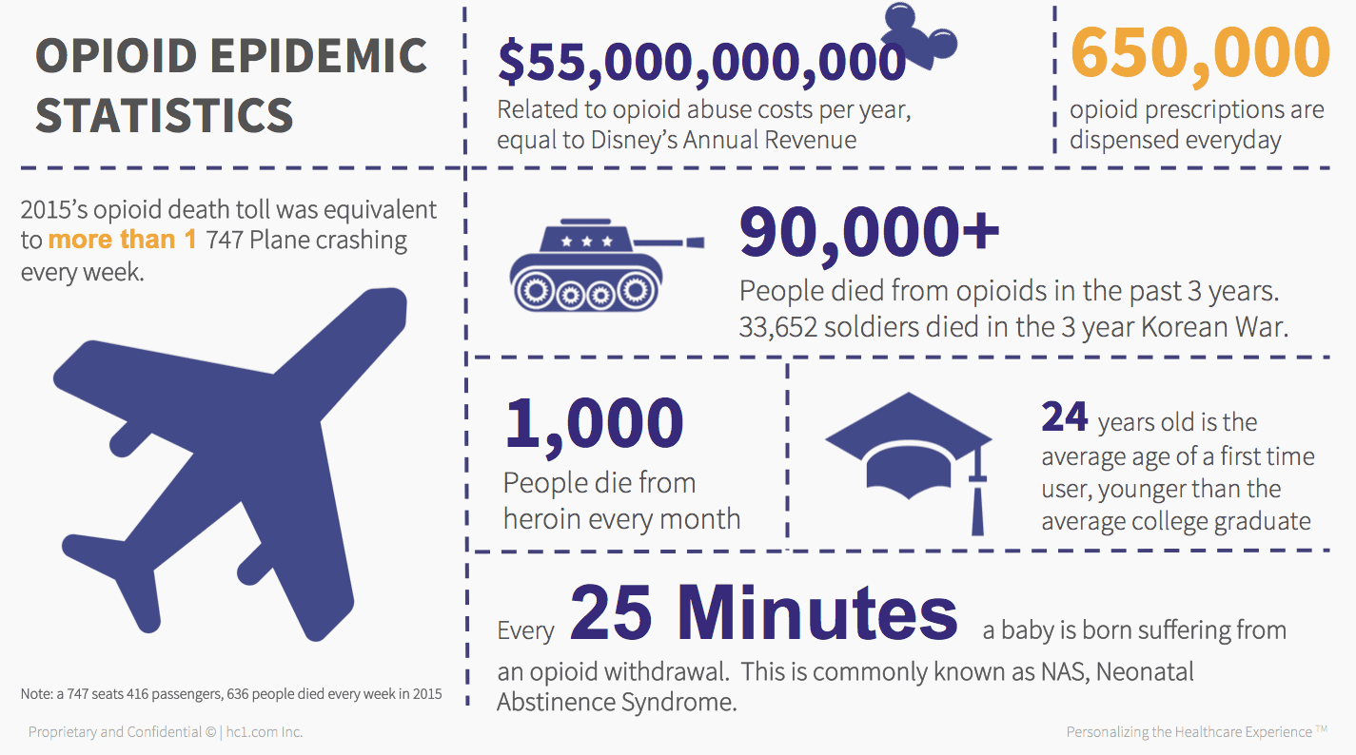
Background & Motivation
We wanted to study a topic which would involve a social problem to potentially use ML to help solve it
The opioid crisis is one which is agnostic of borders and endemic to many countries
We chose to focus on the US due to the availability of public datasets
Image source: Virgil, Sarah. “The Opioid Crisis Is Now Officially A National Emergency. Now What?” Hc1.com Inc, https://www.hc1.com/blog/the-opioid-crisis-is-now-officially-a-national-emergency-now-what/

Slide 3
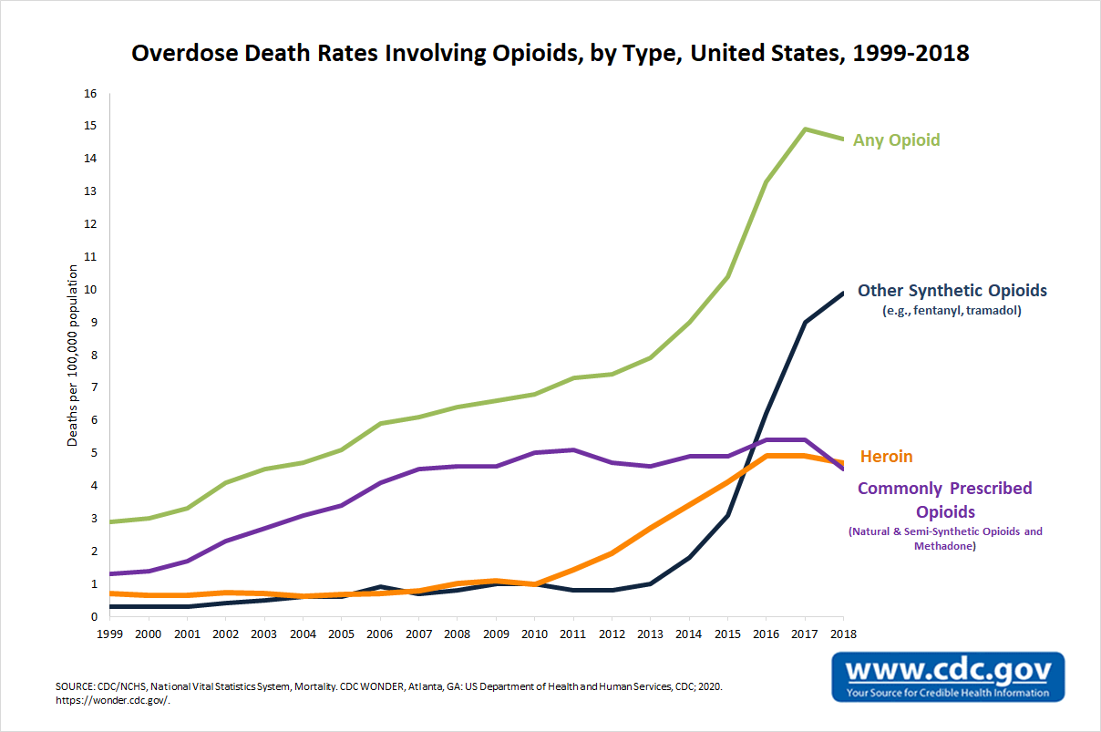
The Opioid Crisis in the United states
1803 → morphine distributed to soldiers in Civil War for pain relief, many became addicted
Overdose deaths increased from 2,000 deaths a year in the 1970s to 93,000 a year in 2020 ^{[1]}
The scale of the crisis has been enough to reduce life expectancy in the United States below its peak in 2014 to today ^{[2]}
The CDC estimates that the total "economic burden" of prescription opioid misuse alone in the United States is $78.5 billion a year, including the costs of healthcare, lost productivity, addiction treatment, and criminal justice involvement ^{[3]}

Slide 4

Previous/Related Works
Machine Learning scholarly research is primarily focused on users of opioids, specifically predicting opioid misuse (scholars like Huinker ^{[4]} analyze these possible models)
Northeastern’s Angela Kilby ^{[5]} and Lo-Ciganic W et al ^{[6]} investigate issues with algorithmic methods currently being used in locales such as medical offices and police departments.
Critique of machine learning algorithms predicting one’s chances of opioid abuse is so prevalent that even mainstream journalistic sources cover the topic, as in Szalavitz’s expose in Wired ^{[7]}

Slide 5
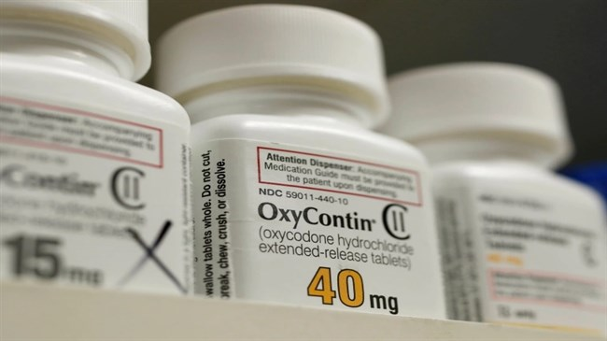
Our approach
We focus more on opioid prescribers rather than opioid users
We use federal datasets to do broad analysis, state-level ones to see how well those predictors fare
We are broad in our analysis, focusing on 3 specific concepts:
Studying the impact of lobbying groups on opioid prescriber rates
Using federal data to build a classifier which can identify doctors who prescribe opioids
Using that classifier to gain state-level insights, specifically for the state of Connecticut
Image source: https://irandaily.ir/content/imgcache/file/291108/0/image_650_365.jpg

Slide 6
Analysis 1 → Studying the impact of lobbying groups on opioid prescriber rates (Yoselyn)
Pharmaceutical companies make large contributions to the government, which could contribute to the opioid crisis
Opioid distributions vary between states, so it is possible that some patients are more likely to be prescribed opioids depending on their location
Being able to predict opioid prescribing rates can help identify patterns that influence prescribing practices

Slide 7
The data
Data for a 2 year period included prescribing rates in the US, annual lobbying contributions from large pharmaceutical companies, and retail drug distribution in the US
Features include: breakout(urban/rural), total opioid prescriber, total prescription claims, total opioid distribution in grams, annual pharmaceutical companies, opioid prescribing rates changes, state

Slide 8
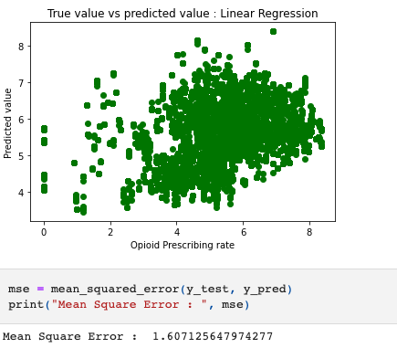
1st feature selection results

Slide 9
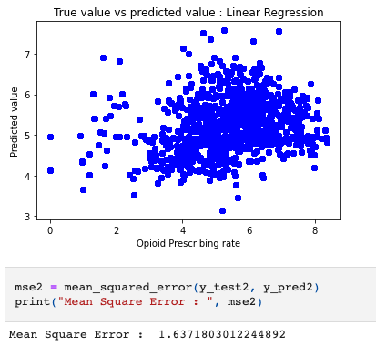
2nd feature selection results

Slide 10
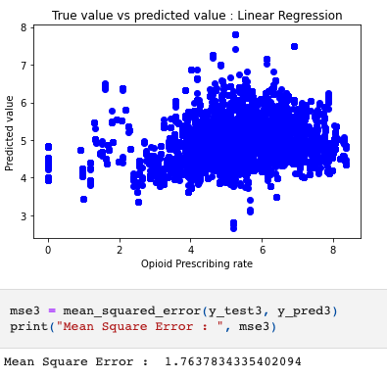
3rd Feature selection results

Slide 11
observations
Low square mean error does not imply a successful model
No significant patterns could be observed using linear regression
The data cleaning process could benefit from collaboration with field experts

Slide 12

Analysis 2 → Using Federal data to classify doctors who prescribe opioids (Adithya)
Unnecessary prescriptions potentially play a significant role in the increase in opioid overdoses.
Patients who do not truly need the medication run the risk of becoming addicted themselves.
Find the likelihood that a provider would prescribe an opioid.

Slide 13
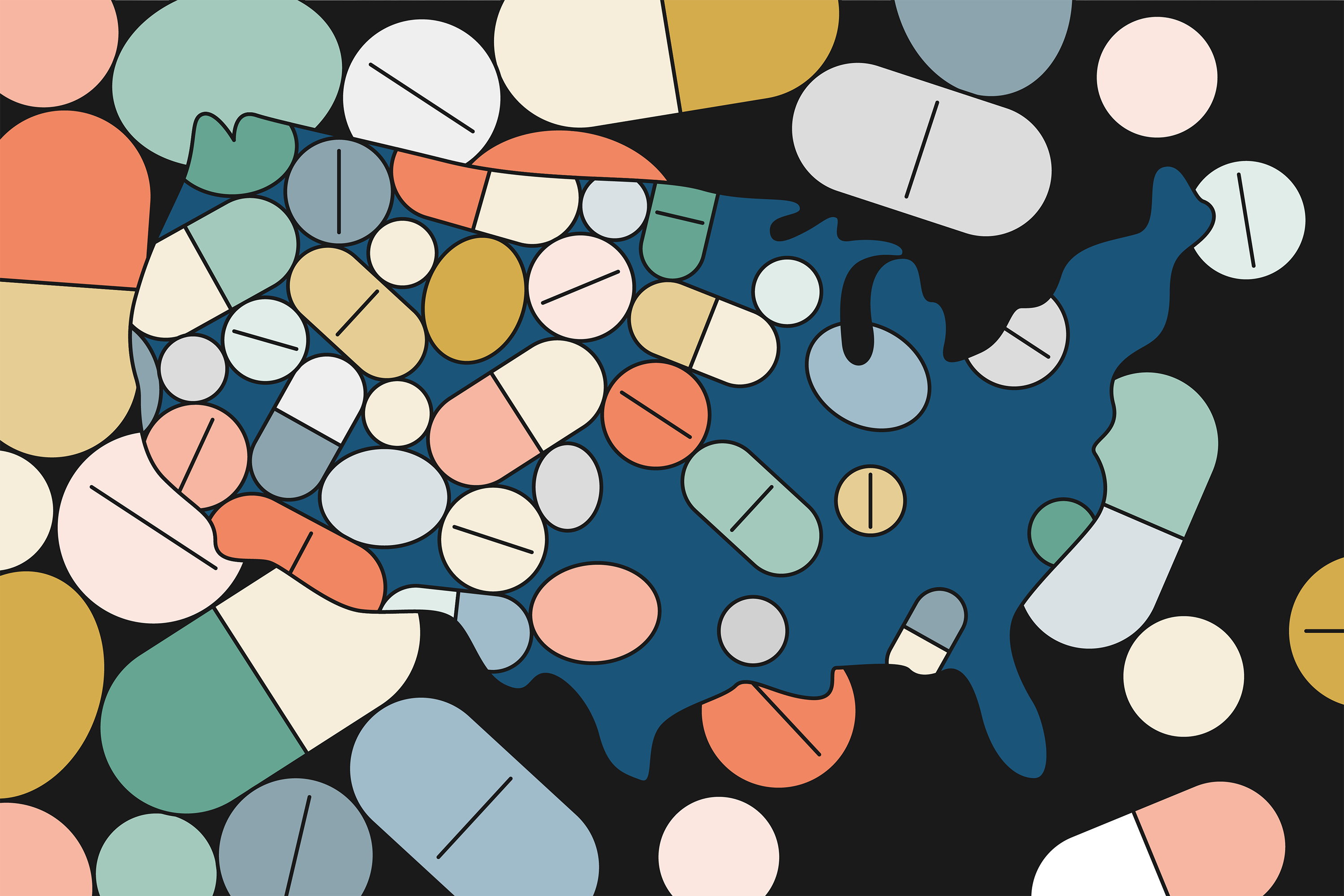
Building our Prediction Model
Understanding our dataset.
Data Preprocessing.
Building the model classifiers.
Validating the model.

Slide 14

Understanding the Dataset
Summaries of prescription records for 250 common opioid and non-opioid drugs written by 25,000 unique licensed medical professionals.
Features – Gender, State, Credentials, Specialty, Opioid-Prescriber Label & List of Drugs.

Slide 15

OBSERVATIONS
Most widely prescribed opioid - Hydrocodone(Vicodin).
Most Common Prescribers – Surgeons.
California had significantly more deaths than any other states.
West Virginia had the highest death per capita.

Slide 16

Prediction – classification algorithms
The Perceptron
K-Nearest Neighbors
Gaussian Naïve Bayes
Decision Trees
Gradient Boosting

Slide 17
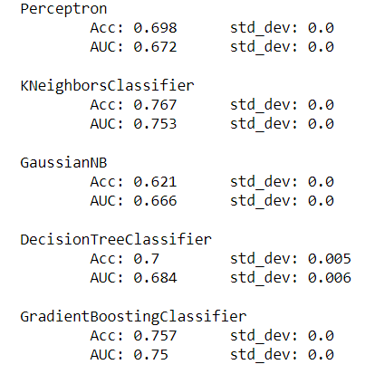
MODEL EVALUATION - 1
TRAIN-TEST SPLITS

Slide 18
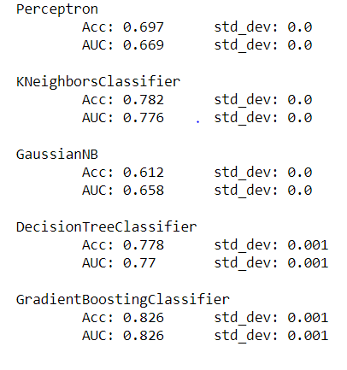
MODEL EVALUATION - 2
5 – CROSS VALIDATION

Slide 19
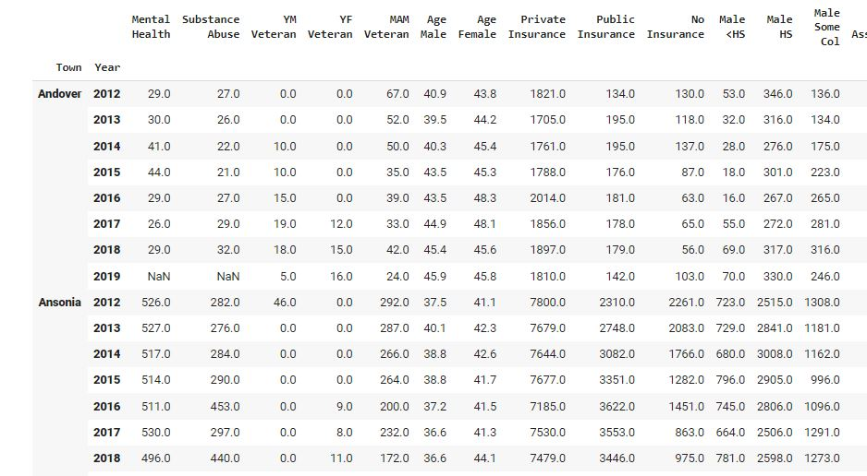
Analysis 3 → using XGBOOST to gain state-level insights (Matthew)
Training Data
All from Connecticut
1990-2020
Data for all 170 towns
500+ possible features
Examples
Examples are town-year pairs
Features
Chose 47 features representing demographic, economic, social, and health measures
Target
Dataset of over 7,000 opioid overdose deaths in Connecticut including town of residence, town of death, drug in system, gender, and age
Model
Two XGBoost models
One predicts the absolute number of opioid overdoses in a town
Other predicts year over year increase in opioid deaths
Goal: Incorporate prescriber data to measure effect of opioid prescribers on absolute deaths and increases in deaths on a yearly basis
Data still needs to be incorporated
Built webscraper for gathering data on ~100,000 prescribers

Slide 20
Analysis 3 → Model Considerations
Sparsity
Final dataset is 1360 x 48
Pulled from a variety of sources
Different ways of demarcating null or 0 value, i.e., -9999 for some and n/a for others
Need sparsity-aware algorithm
Regression vs Classification
Want to produce a predicted continuous numerical value rather than category
Avoiding overfitting
Data is specific to CT, want model to be applicable more broadly
Relatively high number of features
Other contexts might not have as much availability of data, need some sort of feature selection
Differentiating similar examples
Trees are intuitive – find the features and thresholds that make similar towns more or less prone to opioid overdose than each other
Used
XGBoost XGBRegressor
Repeated Kfold Cross-Validation
Hyper Parameter Tuning Example:
Max Tree Depth
First Round R2, max depth = 3
[0.83367895 0.79712296 0.7990098 0.71026113 0.86104418 0.82915942 0.72316052 0.8577774 0.83405094 0.77241975]
First Round R2, max depth = 3
[0.89380145 0.74072155 0.69737939 0.82345255 0.94456512 0.88726331 0.90634053 0.94848285 0.8872857 0.81922939]
Second Round R2, (max depth = 10)
[0.89096147 0.7664509 0.81726148 0.84568197 0.90151306 0.88726542 0.90190783 0.92198349 0.89072471 0.84510481]
Last Round R2, (max depth = 20)
[0.89181561 0.76394626 0.80460541 0.84774121 0.90383411 0.87432013 0.89459039 0.9176789 0.88813752 0.8433758 ]

Slide 21
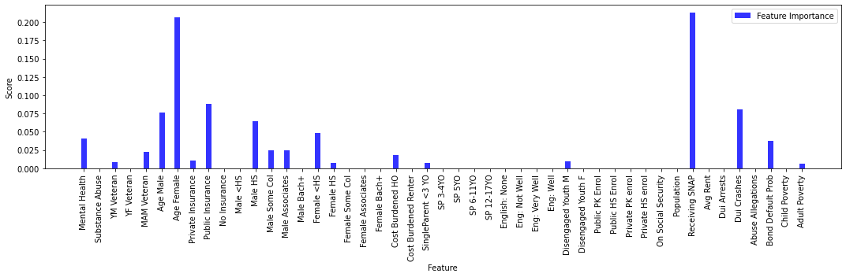
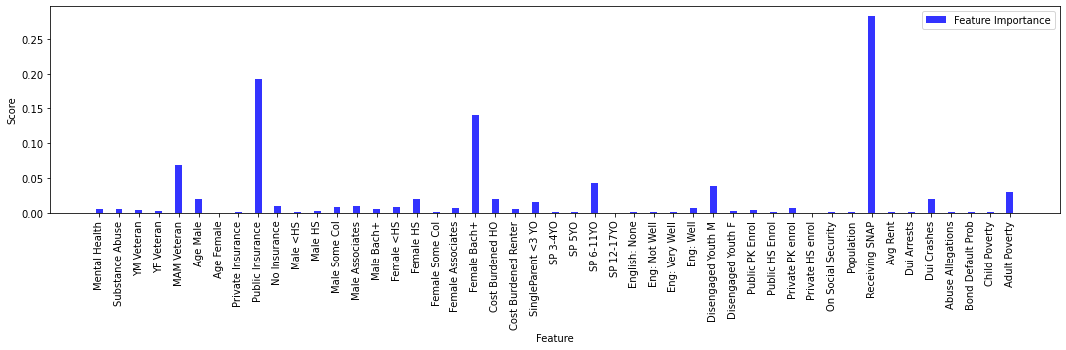
Max Depth = 1
Max Depth = 3

Slide 22
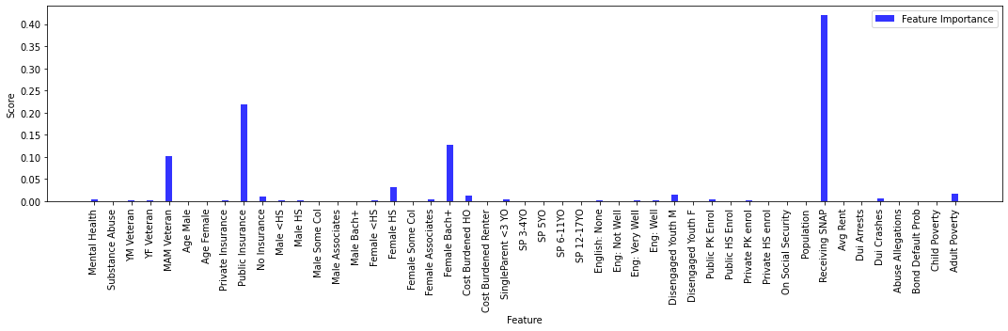
Max Depth = 10
Max Depth = 1
Max Depth = 20
Max Depth = 20

Slide 23
Analysis 3 → using XGBOOST to gain state-level insights (Matthew)
Next Steps
Wealth of provider information to be cleaned and added as features (number of health care providers by type by town)
Validate using data from other states
Try XGBoost model on different target metrics like per-capita deaths, deaths per particular drug (i.e. fentanyl)

Slide 24

Overall findings
Lobbying didn’t have as much of an impact as we thought on opioid distribution rates (no significant correlation)
Regression didn’t work best for this analysis
For the prediction model, gradient boosting classifier worked best, followed by KNN
For the state model, gradient boosting also worked well, but we worry about potentially overfitting – with more time we would like to verify with other data, etc
Model efficacy is hard to determine without other state data
We think our contributions can certainly lead to future work around this topic
Image source: https://i1.wp.com/www.studentdoctor.net/wp-content/uploads/2018/07/20180726_opioid_783935359.png?resize=800%2C445&ssl=1

Slide 25
Sources Referenced
[1] “Unintentional Drug Poisoning in the United States”, Center for Disease Control, https://www.cdc.gov/medicationsafety/pdfs/cdc_5538_ds1.pdf
[2] Dowell D, Arias E, Kochanek K, et al. Contribution of Opioid-Involved Poisoning to the Change in Life Expectancy in the United States, 2000-2015. JAMA. 2017;318(11):1065–1067. doi:10.1001/jama.2017.9308
[3] Florence CS, Zhou C, Luo F, Xu L. The Economic Burden of Prescription Opioid Overdose, Abuse, and Dependence in the United States, 2013. Med Care. 2016;54(10):901-906. doi:10.1097/MLR.0000000000000625.
[4] J. Huinker. Using machine learning to predict prescription opioid misuse in patients. Iowa State University Digital Repository, 194, 2019.
[5] A. E. Kilby. Algorithmic fairness in predicting opioid use disorder using machine learning. In Proceedings of the 2021 ACM Conference on Fairness, Accountability, and Transparency, FAccT ’21, page 272, New York, NY, USA, 2021. Association for Computing Machinery.
[6] W.-H. Lo-Ciganic, J. L. Huang, H. H. Zhang, J. C. Weiss, Y. Wu, C. K. Kwoh, J. M. Donohue, G. Cochran, A. J. Gordon, D. C. Malone, C. C. Kuza, and W. F. Gellad. Evaluation of machine-learning algorithms for predicting opioid overdose risk among medicare beneficiaries with opioid prescriptions. JAMA Network Open, 2(3):e190968–e190968, 03 2019.
[7] M. Szalavitz. A drug addiction risk algorithm and its grim toll on chronic pain sufferers, Wired, 08 2021.

Slide 26
Questions?

